Slide 1


DONE BY
S.KRITHIK GOKUL
PROJECT TITLE: Cricket Perfector: AI-Powered Cricket Analytics and Performance Enhancement System

Slide 2
CONTENTS
ABSTRACT
THEME
PROBLEM STATEMENT
ALGORITHMS USED
EXISTING SYSTEM
PROPOSED SYSTEM
SOFTWARE REQUIREMENTS
DEVELOPEMENT AND DEMONSTATION
BLOCK DIAGRAM
ADVANTAGES
APPLICATIONS
FUTURE SCOPE / REFERENCES

Slide 3
ABSTRACT
The proposed AI-driven system, named "CricketCoachAI," aims to revolutionize cricket by providing players with personalized performance insights and real-time recommendations during matches. By analyzing historical data, playing styles, and physical condition, CricketCoachAI offers tailored guidance on field placements, batting strategies, and bowling techniques, empowering players to make informed decisions that optimize their performance.

Slide 4
THEME
THEME TITLE:WorldCup Wizard
Smart Player Performance Enhancement:-
Create an AI-driven system that provides cricket players with personalizedperformance insights. Analyze players' historical data, playing styles, and physicalcondition to offer real-time recommendations during matches. Enhance players'decision-making on field placements, batting strategies, and bowling techniques.

Slide 5
PROBLEM STATEMENT
Elite cricketers face a plethora of challenges in making optimal decisions during matches. The dynamic nature of the game, coupled with the vast amount of data available, often leads to information overload and decision fatigue. Traditional coaching methods, while valuable, often lack the real-time specificity and personalization required to maximize performance in high-pressure situations.

Slide 6
ALGORITHM USED TECHNIQUES
Data Collection and Preprocessing
Machine Learning
Real-time Recommendations and Feedback

Slide 7
EXISTING SYSTEM
Traditional coaching methods rely on human expertise and observation to provide guidance to players. While these methods have proven effective, they are often limited by the coach's ability to process and analyze vast amounts of data in real-time. Additionally, traditional coaching may not be able to provide the level of personalization required to cater to each player's unique strengths and weaknesses.

Slide 8
PROPOSED SYSTEM
CricketCoachAI complements and enhances traditional coaching methods by providing a continuous stream of personalized data-driven insights. The system's ability to process and analyze large datasets in real-time allows it to identify patterns and correlations that may be overlooked by human observers. Additionally, CricketCoachAI's personalized recommendations enable players to make more informed decisions based on their individual strengths, weaknesses, and the specific context of the match.

Slide 9
SOFTWARE REQUIREMENTS
VISUAL STUDIO CODE-WINDOWS 10 OS
MONGODB COMMUNITY
MONGODB COMPASS
POSTMAN
POSTMAN AGENT

Slide 10
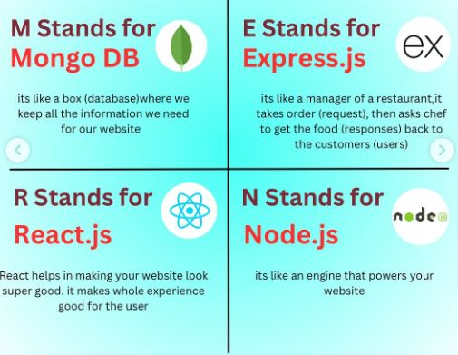
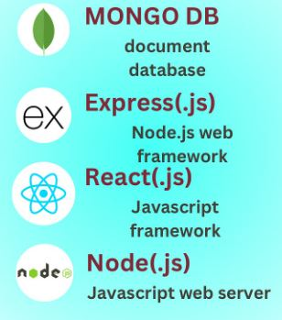
DEVELOPMENT

Slide 11
BLOCK DIAGRAM
Data Collection and Preprocessing
Feature Engineering
Machine Learning Algorithms
Player Performance Optimization
Recommendations and Feedback

Slide 12
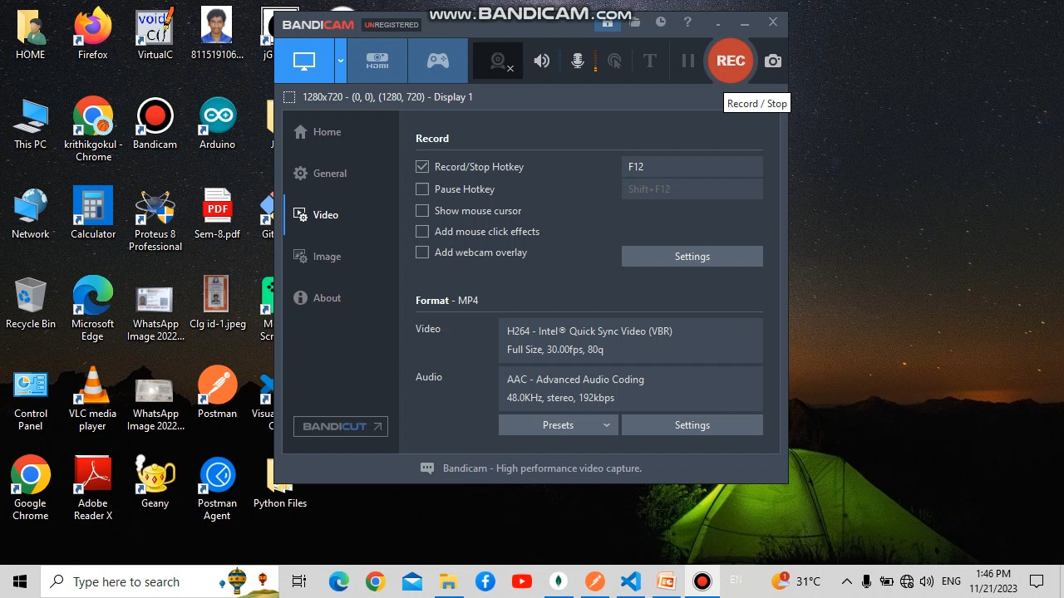
DEMONSTRATION VIDEO
#GeeksforGeeks

Slide 13
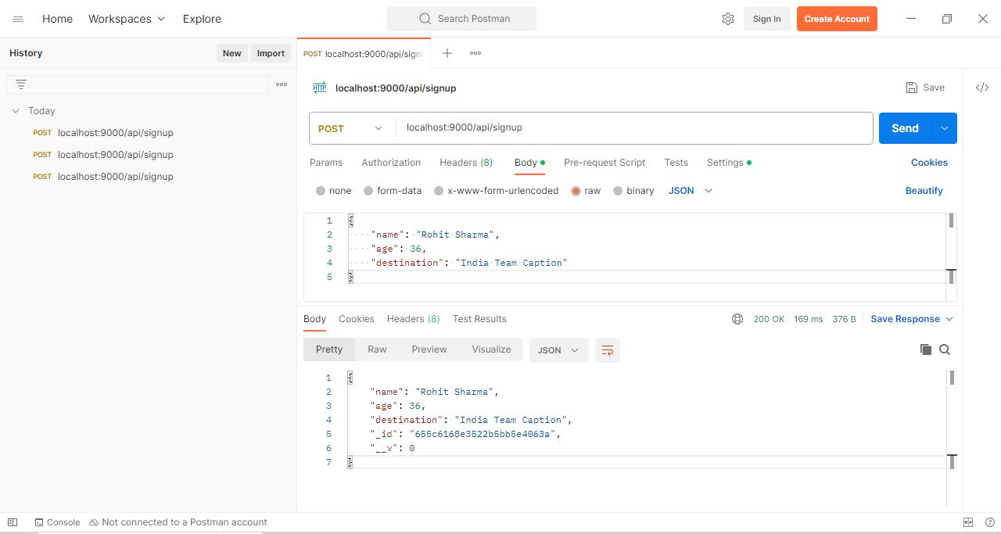
OUTPUT SIMULATION USING POSTMAN

Slide 14
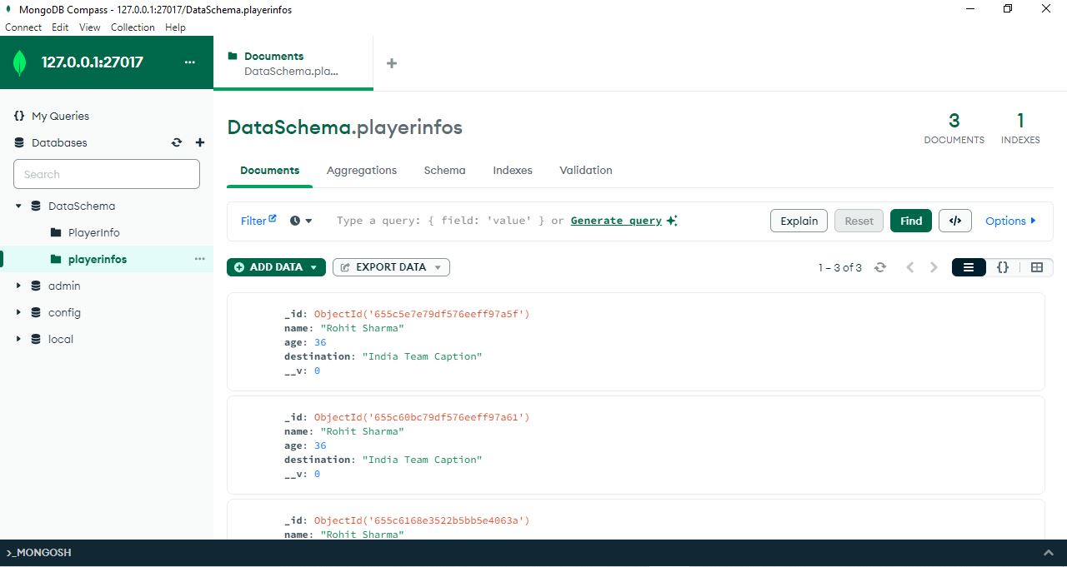
OUTPUT SIMULATION USING MONGODB

Slide 15
ADVANTAGES
Personalized Performance Insights: Cricket Perfector analyzes each player's unique strengths, weaknesses, and tendencies to provide tailored recommendations that maximize their individual potential.
Real-time Decision Support: During matches, Cricket Perfector delivers real-time suggestions on field placements, batting strategies, and bowling techniques, enabling players to adapt to the game's dynamic nature.
Enhanced Tactical Awareness: The system's deep understanding of player behavior and game dynamics empowers players to make informed decisions that outmaneuver their opponents.
Optimized Training Regimens: Cricket Perfector provides data-driven insights into training patterns and injury risks, enabling players to tailor their training regimens for optimal performance and injury prevention.

Slide 16
APPLICATIONS
The CPA system can be applied in various scenarios to enhance cricket performance:
Player Training and Development: The system can provide personalized training plans and feedback to help players improve their skills, fitness, and decision-making abilities.
Match Preparation and Analysis: The system can analyze upcoming opponents and provide insights into their strengths, weaknesses, and playing styles, aiding in strategic planning.
Real-time Game Support: During matches, the system can provide real-time recommendations to players, helping them make informed decisions based on the evolving game situation.
Performance Evaluation and Feedback: After matches, the system can provide comprehensive performance evaluations and feedback to help players identify areas for improvement and track their progress over time.

Slide 17
FUTURE SCOPE
Integration with Wearable Technology: Integrating Cricket Perfector with wearable devices will enable continuous monitoring of players' physical condition and provide real-time feedback on exertion levels and fatigue management.
Predictive Analytics for Match Outcomes: Advanced machine learning algorithms can be trained to predict match outcomes based on real-time data, providing coaches and captains with a competitive edge.
AI-Powered Umpiring and Decision Review Systems: Cricket Perfector's ball-tracking and trajectory prediction capabilities can enhance the accuracy of umpiring decisions and provide real-time support for the Decision Review System (DRS)

Slide 18
CONCLUSION
CricketCoachAI has the potential to revolutionize cricket by empowering players with personalized performance insights and real-time recommendations. By leveraging the power of AI, the system can help players make informed decisions that optimize their performance and contribute to team success. As AI technology continues to evolve, CricketCoachAI is poised to become an indispensable tool for cricket players at all levels of competition.

Slide 19
REFERENCES
"Revolutionizing Cricket: The Impact of Artificial Intelligence on the Sport" by Blogie on Medium
"AI-powered cricket innovation: Transforming the game" on LinkedIn
"How AI is used in Cricket" by Mad About Sports
"Transforming Cricket with AI and Data Analytics" on LinkedIn

Slide 20


